Slide 1

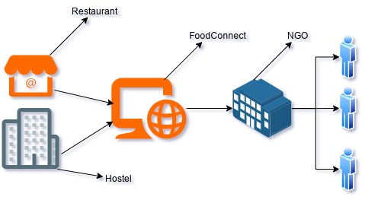
Department of Computer Science & Engineering
Project Title:
FoodConnect: A Digital Platform for Reducing Food & Combating Hunger
PROBLEM IDENTIFICATION
Guide:
Manchala Manasa,
Assistant Professor
Batch No:B_08
Food waste and hunger are major urban challenges, with restaurants and hostels generating surplus food daily while many people remain food insecure. The lack of clear donation channels leads to wastage and inefficiencies in food redistribution. Key issues include poor coordination, logistical barriers, and food safety concerns.
Students:(21QM1A05__)
Bhavitha Mosarla(78)
Muntasirul Islam (82)
Shruthi Thakur (B0)
Ravulakollu Pranay (A2)
Department:
CSE
PROBLEM STATEMENT
Food waste and hunger impact city sustainability and social well-being. Restaurants and hostels generate surplus food daily, but a lack of clear channels for food donation and distribution hinders efforts to address food insecurity.
CONCEPTUAL DESIGN
DEVELOPMENT SPECIFICATION
The proposed system connects restaurants and hostels with NGOs to efficiently deliver surplus food to those in need. It provides an intuitive, eco-friendly interface for donors and takers to facilitate food distribution seamlessly. The platform ensures secure access through role-based authentication, verifying users before participation. With real-time tracking and scheduling, the system optimizes food redistribution while ensuring safety and transparency. Most importantly, all food donations are distributed free of cost, promoting sustainability and reducing food waste.
The system will be developed as a web and mobile-based application, ensuring seamless food donation and distribution. ReactJs is used for design the frontend and NodeJS, ExpressJs is used for handling backend server, while MongoDB is used for manage user roles, data, food listing, order history/update etc.
RESULT & APPLICATION
The system ensures efficient food redistribution by connecting surplus food providers with NGOs, reducing waste. Its order updating, and secure authentication enhance transparency.

